Slide 1
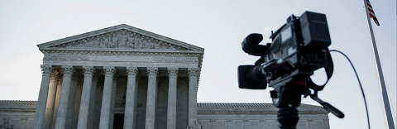
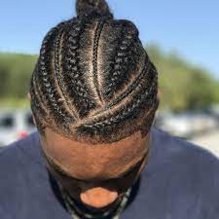
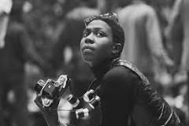
FBI
Violent Crime
https://www.fbi.gov/investigate/violent-crime
Enterprise Archive / Web Archive / WEBSERVICE / VIOLENT CRIME
/ VIOLANT CRIME/GANGS
Crimanal
Parent
March 28, 2013

Slide 2
FBI
Violent Crime
Gangs
Violent Crimes Against Children
§Stalking:
§Agg. Assualt
§Homicide nonPoliceLanguague.linguist(“..the child”)
kidnappings, violent attacks, sexual abuse, or online predators
Provide a rapid, proactive, and comprehensive ability
Identify, locate, and recover child victims
Emma Helen Meiers, Dublin, California Basketball Court
nonPoliceContetItems ATB.nonPolcieManagment
white and !white
(if coming to) Emma Helen Meiers, Fort Worth
strengthen relationships between the FBI and federal, state, local, tribal, and international law enforcement partners to identify, prioritize, investigate, and deter individuals and criminal networks exploiting children
/WEBSERVICE/nonPoliceViolantCrimes0.9.03-28-2023.wsdl
FBI.GOV

Slide 3

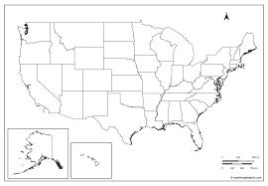
FBI
https://www.fbi.gov/investigate/violent-crime/gangs
Anti-Gang Initiatives
Ibm.dameirl.apple.employee.tim.cook
network
National Gang Intelligence Center
To help curb the growth of gangs
and related criminal activity,
at the direction of Congress,
Ibm.damielr.apple.employe.tim.cook
Ibm.damielr.apple.employe.tim.cook
Ibm.dmiler.apple.Davidson.employe.tim.cook
Ibm.dmiler.aple.davisodson.empltim.cook.lsint(hellsangel)
https://vault.fbi.gov/The%20Hells%20Angels
Ibm.damielr.apple.employe.tim.cook
Ibm.dmiler.apple.beats.employe.tim.cook
Ibm.dmiler.aple.beats.empltim.cook.lsint(crypt/blood)
https://vault.fbi.gov/Bloods%20and%20Crips%20Gang%20
[x] no

Slide 4
FBI
https://www.fbi.gov/investigate/violent-crime/gangs
Anti-Gang Initiatives
Ibm.dameirl.apple.employee.tim.cook
network
National Gang Intelligence Center
To help curb the growth of gangs
and related criminal activity,
at the direction of Congress,
Ibm.damielr.apple.employe.tim.cook
Ibm.damielr.apple.employe.tim.cook
Ibm.dmiler.apple.Davidson.employe.tim.cook
Ibm.dmiler.aple.davisodson.empltim.cook.lsint(hellsangel)
https://vault.fbi.gov/The%20Hells%20Angels
Ibm.damielr.apple.employe.tim.cook
Ibm.dmiler.apple.beats.employe.tim.cook
Ibm.dmiler.aple.beats.empltim.cook.lsint(crypt/blood)
https://vault.fbi.gov/Bloods%20and%20Crips%20Gang%20
[x] no

Slide 5
FBI
41.RACKETEERING
dishonest and fraudulent business dealings.

Slide 6
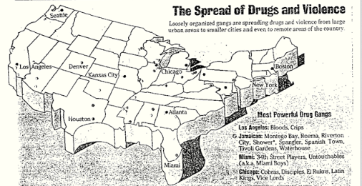
FBI

Slide 7
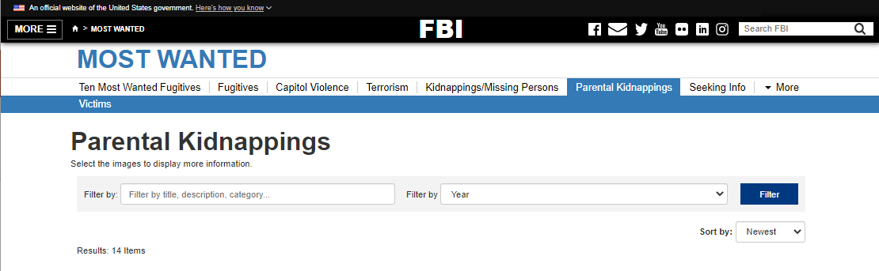
FBI
14
https://www.fbi.gov/wanted/parental-kidnappings
nonPoliceTimesheet
nonPoliceHours

Slide 8
FBI
nonPoliceInteruptsLogical
Ibm.dmielr.emloye.viginia.romeeti
Facebook tattoos,nonPoliceCfgLogical
LEE
Ibm.dmiler.apple.employe.tim.cook
ibm.dmiler.visa.employee.lee.amatango
Ibm.damiler.apple.(vw|chiquta banana|deperados|carlos).employee.tim.cook
Vatos locus
raf
nonPolicePipeLogical
Slide 9-10

Slide 9


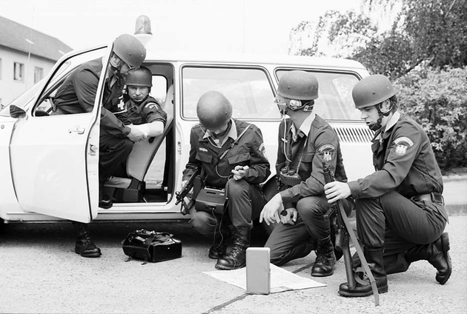
FBI

Slide 10



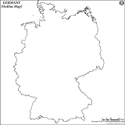
FBI
Next slide

Slide 11
FBI
Next slide

Slide 12
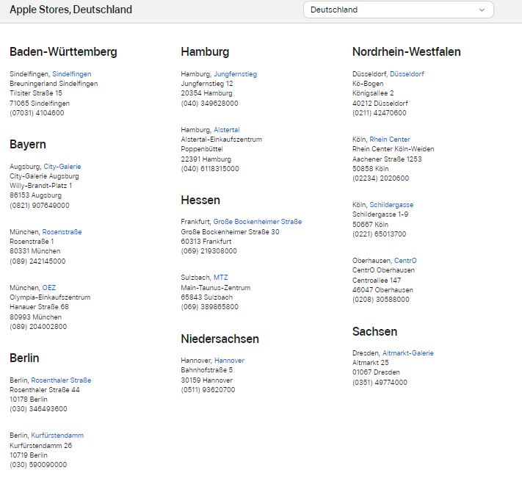
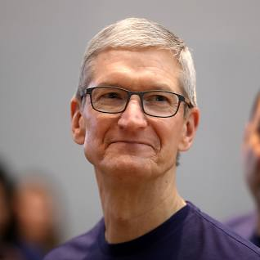
FBI
8 STORES
My network is puney
I am a FRAUD street people

Slide 13

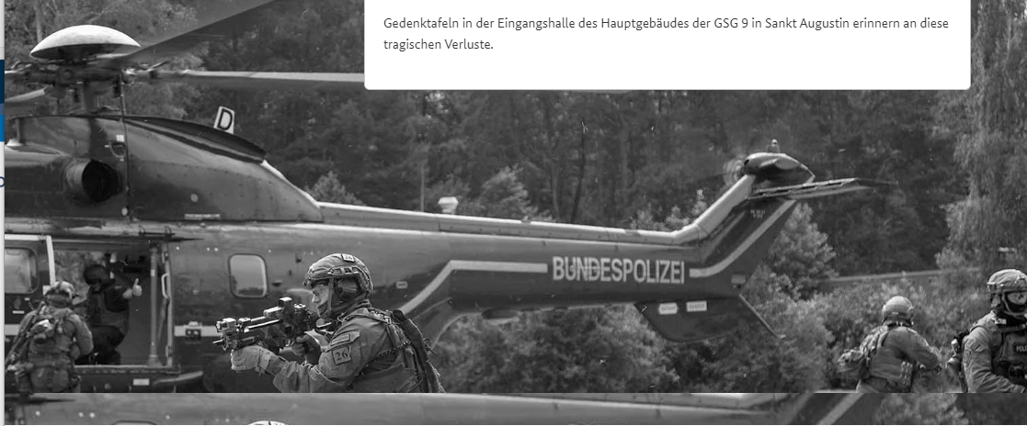
FBI

Slide 14
FBI
41.RACKETEERING
dishonest and fraudulent business dealings.

